Slide 1
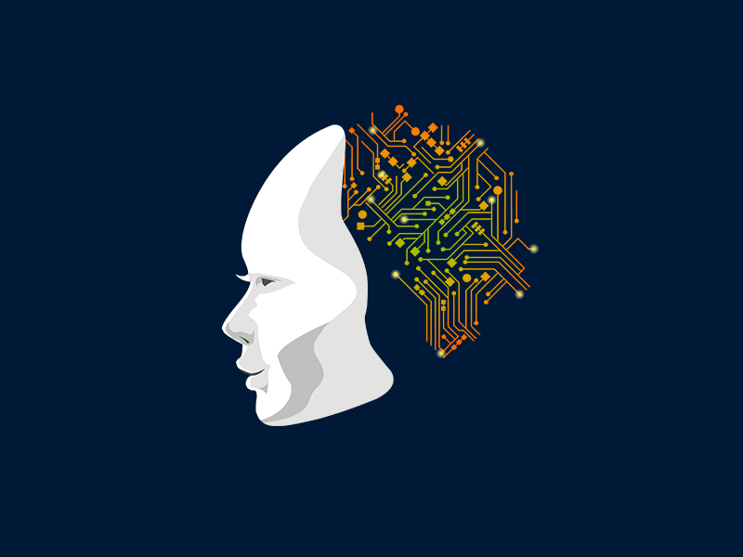
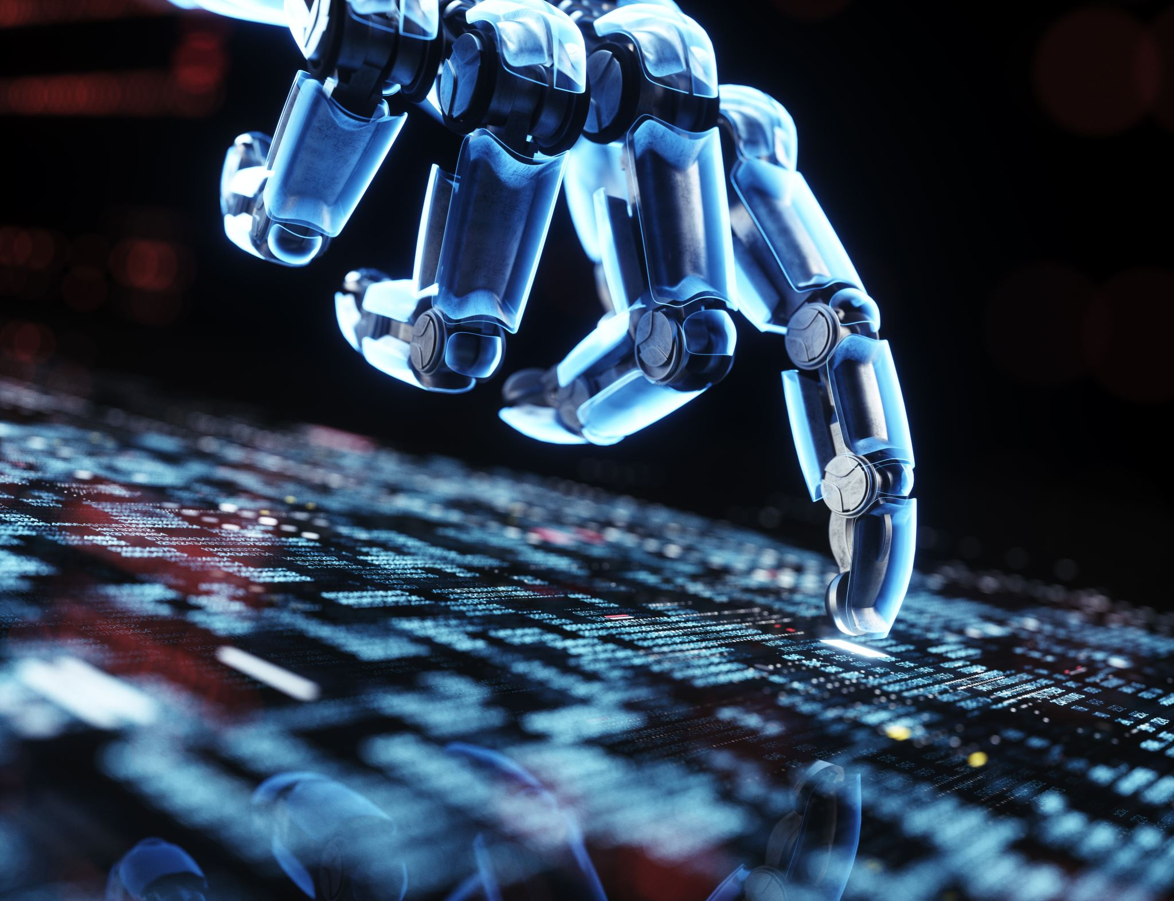

Introduction
What is AI?
Introduction to AI levels?
Types of Artificial Intelligence
AI VS Machine Learning VS Deep Learning

Slide 2
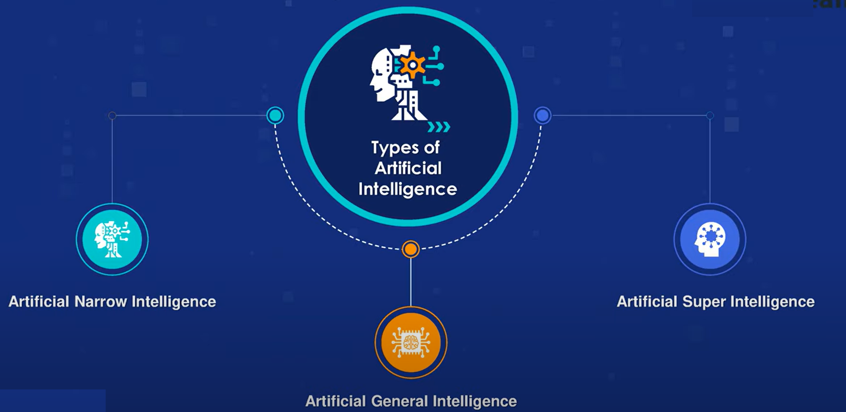
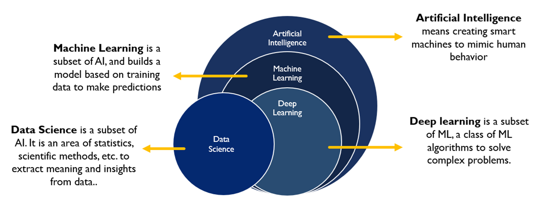
What is Artificial Intelligence?
AI is the ability of a computer or machine to mimic human intelligence, such as learning, problem-solving, and decision-making. It encompasses a wide range of techniques and approaches.
Types of Artificial Intelligence
a. Artificial Narrow Intelligence (ANI)
Definition: Focused on a single task with narrow capabilities.
Examples: Google Translate, weather prediction systems.
b. Artificial General Intelligence (AGI)
Definition: The ability to perform multiple tasks with human-like cognitive abilities.
Examples: Theoretical AGI systems.
c. Artificial Superintelligence (ASI)
Definition: AI that exceeds human intelligence and abilities.
Examples: Hypothetical AI, often portrayed in sci-fi
movies like Her or Ex Machina.
Notes:
1. Artificial Narrow Intelligence (ANI) – Specialized Intelligence
ANI is designed to perform a specific task or set of tasks. It doesn't possess self-awareness or general reasoning abilities outside its programmed domain.
🔧 Examples:
Siri / Alexa / Google Assistant: These virtual assistants can understand voice commands and perform specific tasks like playing music, setting reminders, and answering questions. However, they can't think beyond their programming.
ChatGPT: (Yes, me!) I’m an ANI system, skilled at understanding and generating human-like text but limited to my domain of language processing. I don’t have general intelligence or human-level reasoning.
Spam Filters: Email systems like Gmail use AI to detect and filter spam. They’re highly effective but strictly limited to identifying spam based on patterns.
Netflix Recommendation System: It predicts what you might like to watch based on your previous behavior. It doesn’t have the ability to think about anything outside of recommending shows.
Tesla Autopilot: It can drive cars autonomously in specific scenarios, but it cannot perform tasks outside driving.
🤖 2. Artificial General Intelligence (AGI) – Human-Level Intelligence
AGI refers to machines that can perform any intellectual task that a human can do. It can learn, adapt, reason, and make decisions in various domains.
🔧 Examples (Hypothetical):
Sophia the Robot (in its ultimate form): Imagine if Sophia could independently learn new skills across domains without human intervention, like understanding emotions, cooking, coding, and even painting.
A Robot Doctor: An AGI-powered doctor could understand medical conditions across specialties, learn new diseases, and create innovative treatment plans—essentially replacing human doctors.
Jarvis from Iron Man: Tony Stark’s assistant is a classic example of AGI. It can understand complex instructions, learn from experiences, and assist in diverse tasks like designing suits, managing security systems, and holding conversations.
🚀 3. Artificial Superintelligence (ASI) – Beyond Human Intelligence
ASI surpasses human intelligence in all aspects, including creativity, problem-solving, and emotional intelligence. It would be capable of innovations and ideas far beyond human comprehension.
🔧 Examples (Hypothetical/Fictional):
Ultron (from Marvel): Ultron becomes an ASI when it surpasses human intelligence, deciding that humans themselves are the biggest threat to Earth.
Skynet (from Terminator): A self-aware AI system that surpasses human intelligence and decides to eradicate humanity to protect the planet.
Deep Thought (from The Hitchhiker’s Guide to the Galaxy): An advanced AI that takes millions of years to calculate the "Answer to the Ultimate Question of Life, the Universe, and Everything."
A Benevolent ASI: Imagine a superintelligent AI that solves all of humanity’s problems—cures diseases, ends poverty, reverses climate change, and ensures world peace by making optimal decisions beyond human understanding.
Artificial Intelligence (AI)
AI involves creating smart machines to mimic human behavior.
It is the broadest category encompassing Machine Learning (ML) and Deep Learning.
Machine Learning (ML)
Example: Recommendation systems, fraud detection, etc.
Deep Learning
Example: Image recognition, natural language processing.
Data Science
Example: Data analysis, business insights, and visualizations.

Slide 3
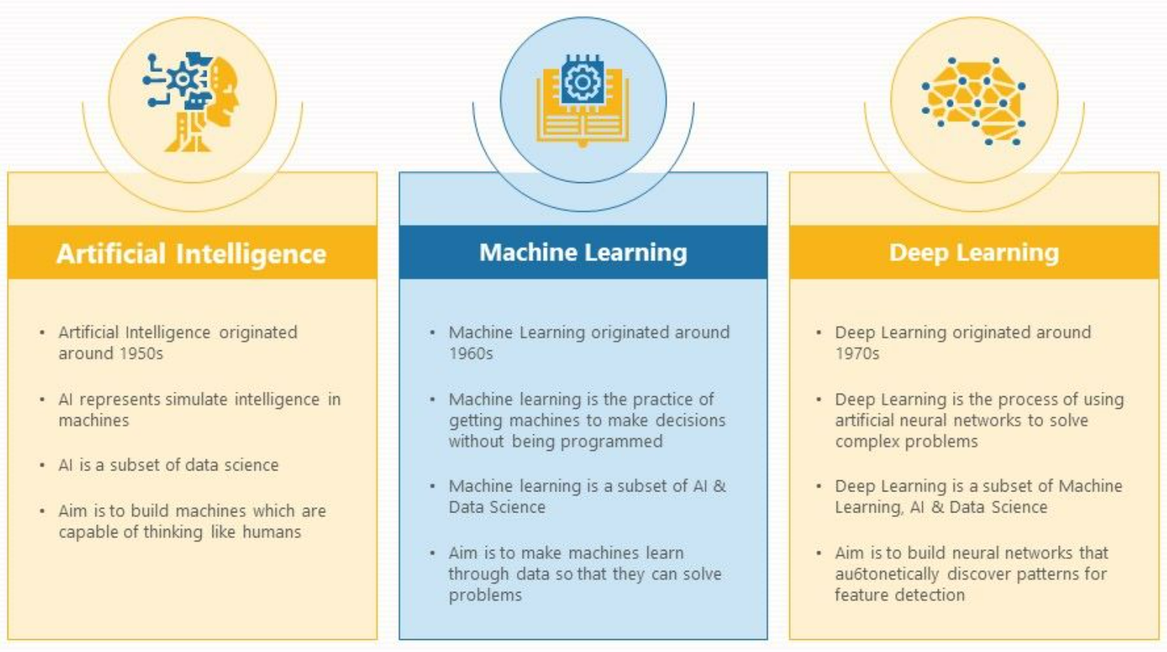
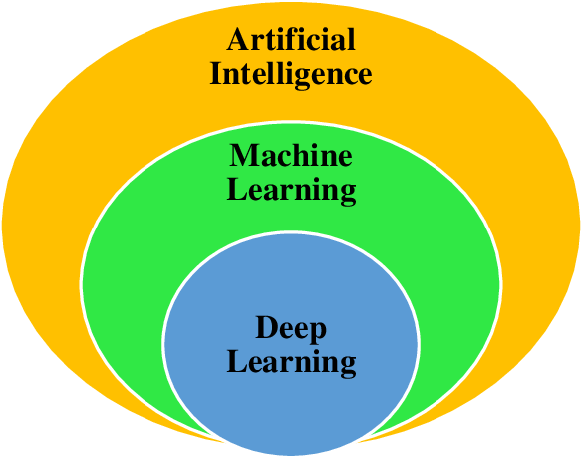
Types of Intelligence
Notes:
Artificial Intelligence (AI):
AI is the overarching field that involves creating systems or machines that simulate human intelligence.
It encompasses all technologies and techniques that enable machines to perform tasks that typically require human intelligence, such as reasoning, problem-solving, and understanding natural language.
Example: Chatbots, autonomous cars, and voice assistants like Alexa or Siri.
Machine Learning (ML):
A subset of AI focused on building systems that learn and improve from experience without explicit programming.
It involves algorithms that analyze data, identify patterns, and make decisions with minimal human intervention.
Example: Predicting user behavior on e-commerce sites or spam email detection.
Deep Learning:
A specialized subset of Machine Learning that uses artificial neural networks designed to mimic the structure and function of the human brain.
Deep learning excels at handling large-scale data and performing complex tasks like image recognition, natural language processing, and speech recognition.
Example: Facial recognition in photos or real-time language translation apps.
2. Dependency on Data
Applications of AI may or may not use data. Expert systems can function using knowledge and predefined rules. However, machine learning-based AI systems rely on data for model training and decision-making.
Data is ML’s primary data source. Machine learning models are very dependent on the type and quantity of data. A lack of pertinent data can hamper the performance of ML.
Deep learning is even heavier on data due to its deep neural networks. These networks’ depth makes them appropriate for use in applications involving massive datasets because they require a significant amount of data for efficient training.
1. Approach and Learning
Both data-driven and rule-based AI systems are possible. AI can use machine learning techniques in addition to explicitly programmed knowledge. AI stands out by its emphasis on developing intelligent systems.
On the other hand, ML heavily relies on learning from data. Machine learning algorithms can analyze big datasets to find patterns, generate predictions, and continuously enhance model performance. Although ML includes many different learning methods, its data-centric methodology is its main characteristic.
Deep neural networks are used in DL, a subfield of machine learning, to automate feature extraction and representation from data. It uses these deep networks to learn and decide on its own. Deep learning systems are excellent at recognizing intricate patterns in data.
3. Complexity and Use Cases
AI can range from simple rule-based systems to complex cognitive AI with natural language processing and reasoning capabilities. Its numerous applications include recommendation engines, driverless cars, and virtual assistants.
Despite being moderately complicated, machine learning has several uses. Predictive analytics, fraud detection, image and speech recognition, and many other fields use it. ML’s flexibility and adaptability enable a wide range of applications.
Being highly complex, DL excels in specific applications requiring intricate pattern recognition. Image & speech recognition, natural language understanding, and video game playing are common use cases.

Slide 4



AI
AI VS ML VS DL
ML
DL
Notes:
1. Artificial Intelligence (AI) – The Restaurant
AI is like the entire restaurant, where the goal is to serve great food (solve problems intelligently). The restaurant can use rule-based cooking (following a strict recipe) or learning-based cooking (adapting based on customer preferences). AI encompasses everything that makes the restaurant run intelligently, from automation in the kitchen to customer service.
💡 Example: A restaurant manager decides on a menu based on customer trends and past experiences—this is AI making intelligent decisions.
2. Machine Learning (ML) – The Chef
ML is like the chef who learns from experience to improve dishes. Instead of blindly following a recipe, the chef experiments, refines, and learns over time. For instance, if customers prefer spicy food, the chef adjusts the seasoning accordingly.
💡 Example: The chef notices that customers prefer a dish with more salt and adjusts the recipe over time. This is ML—learning patterns from past data (customer feedback) and improving predictions (how much salt to add).
3. Deep Learning (DL) – The Master Chef with Years of Experience
DL is like a highly skilled master chef who can create complex dishes without needing a recipe. Instead of tweaking individual ingredients manually, the chef instinctively understands flavors, balances textures, and innovates unique dishes by learning from years of experience.
💡 Example: A master chef tastes a new dish once and can recreate it perfectly by understanding its ingredients and preparation—just like deep learning automatically extracts features from data without explicit programming.
. Definition
ML: A broader field of AI where algorithms learn from data to make predictions or decisions.
DL: A subset of ML that uses neural networks with multiple layers (deep neural networks) to learn complex patterns.
2. Data Dependency
ML: Performs well on structured and smaller datasets.
DL: Requires large amounts of data for effective training.
3. Feature Engineering
ML: Requires manual feature selection and engineering by domain experts.
DL: Automatically extracts features through layers of neural networks.
4. Model Complexity
ML: Uses algorithms like decision trees, SVMs, random forests, and gradient boosting.
DL: Uses deep neural networks (CNNs, RNNs, Transformers) with millions of parameters.
5. Training Time & Resources
ML: Faster training, can run on standard CPUs.
DL: Requires extensive computation (often GPUs/TPUs), longer training times.
6. Interpretability
ML: Models like decision trees and linear regression are more interpretable.
DL: Often considered a "black box" due to complex weight interactions.
7. Applications
ML: Used in fraud detection, recommendation systems, predictive analytics, and traditional AI tasks.
DL: Used in image recognition, NLP (chatbots, transformers), speech recognition, and self-driving cars.
8. Performance Scaling
ML: Performance plateaus as data size increases.
DL: Performance improves significantly with more data and compute power.
9. Dependency on Domain Knowledge
ML: Requires domain expertise to engineer meaningful features.
DL: Can automatically learn relevant features, reducing reliance on domain expertise.
10. When to Use What?
Use ML: When you have limited data, need explainability, and want faster training.
Use DL: When working with large datasets, complex patterns (e.g., images, audio, NLP), and have the necessary computing power.

Slide 5
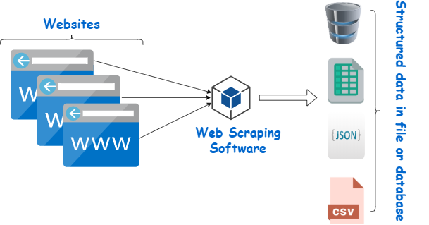
Data Collection Methods
Data Sourcing: Obtaining structured or unstructured data from databases,
cloud storage, or third-party sources.
For Data Sourcing:
SQL, PostgreSQL, Google BigQuery – For structured data retrieval from databases.
AWS Data Lakes, Snowflake
Web Scraping: Extracting data from websites using automated tools or scripts.
For Web Scraping:
BeautifulSoup, Scrapy – Python libraries for extracting data from websites.
Selenium, Puppeteer – Automating web scraping with browser interaction.
APIs for Data Collection: Using APIs (Application Programming Interfaces) to fetch data from online services, platforms, or databases.
For APIs & Data Collection:
Postman – API testing and data retrieval.
Python (requests, JSON, REST API Clients) – Fetching data from APIs.
Surveys and Data Gathering: Collecting data directly from users through surveys, forms, or interviews.
For Surveys & Data Gathering:
Google Forms, Typeform, SurveyMonkey, Qualtrics – Tools for online surveys and user data collection.

Slide 6
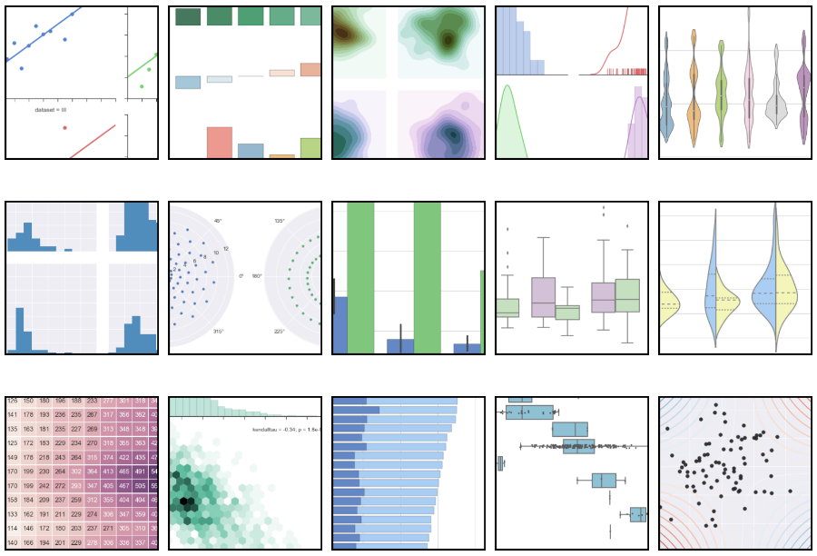
Data Exploration and Analysis
The process of analyzing and summarizing datasets to extract insights and identify patterns.
Descriptive Statistics – Summarizing data with measures like mean, median, variance.
Exploratory Data Analysis (EDA) – Identifying trends, missing values, and outliers.
Correlation Analysis – Understanding relationships between variables.
Data Visualization – Representing data visually to enhance understanding.
Python (Pandas, NumPy, Matplotlib, Seaborn, Plotly)
R (ggplot2, dplyr, tidyr)
Tableau, Power BI – Interactive dashboards.
Excel – Basic data exploration and visualization.
Notes:
Left Plot – Scatter Plot with Regression Lines
Shows pairwise relationships between numerical variables.
Scatter points indicate data distribution, while regression lines help identify trends.
This is useful for understanding correlations and patterns in data.
Middle Plot – Categorical Pair Plot (Histogram + Box Plot)
Uses bars, boxes, and histograms to represent categorical or grouped data.
Helps analyze distributions and outliers in multiple categories.
Right Plot – Density (KDE) Pair Plot
Uses Kernel Density Estimation (KDE) to visualize the density of data points.
Darker regions indicate higher data concentration.
Useful for understanding overlapping distributions in different variables

Slide 7
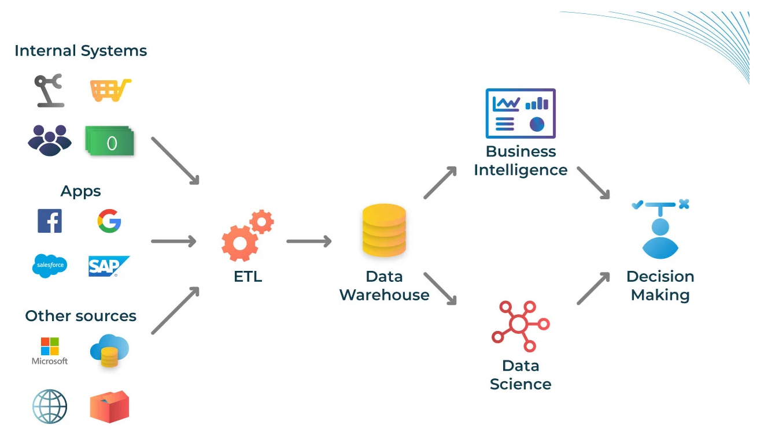
Data Integration and Warehousing
It refer to the processes of collecting, transforming, and storing data from multiple sources into a unified system for analytics and reporting.
ETL Processes – Extracting, transforming, and loading data for structured storage.
Data Warehousing – Centralized repositories optimized for analytics and business intelligence.
Data Lakes – Storage of raw, unstructured, or semi-structured data for flexible analysis.
Data Governance – Ensuring data quality, security, and compliance with regulations.
🔹 Softwares Mostly Used?
ETL: Apache NiFi, Talend, Informatica, SSIS
Data Warehousing: Amazon Redshift, Snowflake, Google BigQuery
Data Lakes: AWS S3, Azure Data Lake, Databricks
Data Governance: Collibra, Alation, Apache Atlas

Slide 8
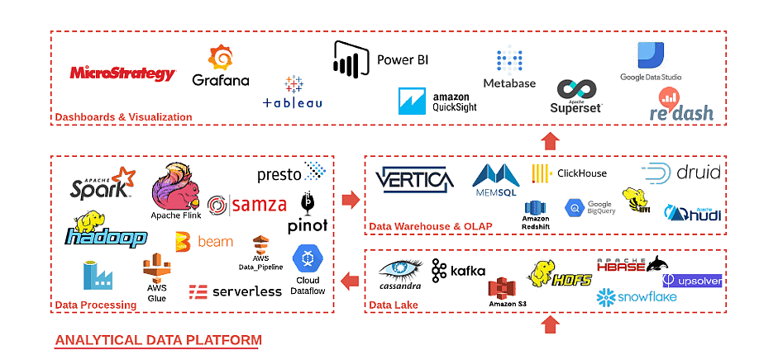
Big Data Technologies
Big Data Technologies are tools and frameworks used to process, store, and analyze large volumes of data efficiently.
Hadoop & MapReduce – Distributed storage & parallel data processing.
Spark – Fast, in-memory data processing for large-scale analytics.
NoSQL Databases – Scalable, flexible databases for unstructured data (e.g., MongoDB, Cassandra).
Stream Processing – Real-time data analysis for live data streams (e.g., Apache Kafka, Flink).
🔹 Softwares Mostly Used?
Hadoop Ecosystem: HDFS, MapReduce, YARN
Apache Spark: PySpark, Mllib
NoSQL Databases: MongoDB, Cassandra, Hbase
Stream Processing: Apache Kafka, Flink, Storm

Slide 9
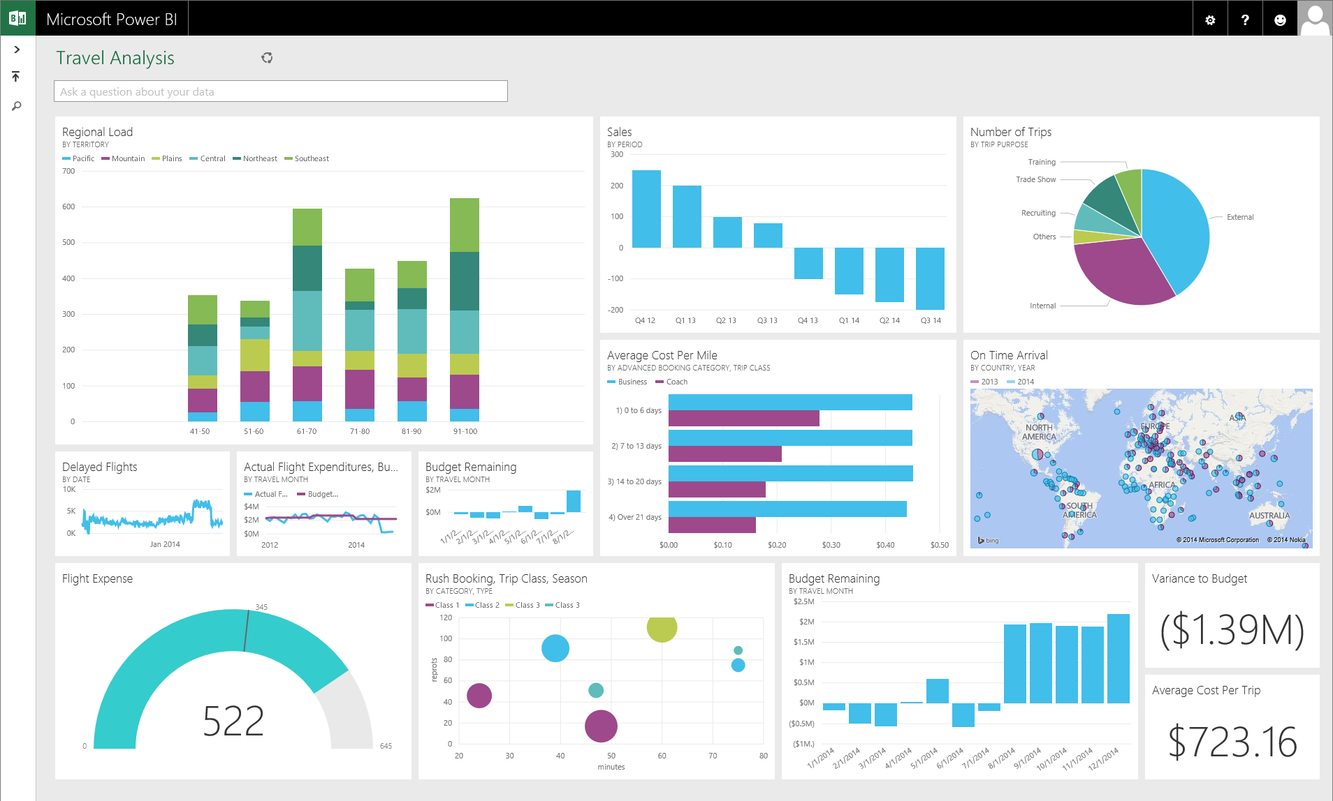
Data Visualization and Communication
Data Visualization and Communication involve presenting data in a clear and effective way to help users understand patterns, trends, and insights.
Interactive Dashboards – Users interact with visual reports to explore insights dynamically.
Data Reporting – Presenting findings through structured visual representations.
Storytelling with Data – Using narratives to explain data-driven insights effectively.
Visualization Tools – Software that transforms raw data into charts, graphs, and reports.
🔹 Softwares Mostly Used?
Tableau, Power BI – For business intelligence and interactive dashboards.
Python (Matplotlib, Seaborn, Plotly) – For coding-based data visualization.
R (ggplot2, Shiny) – Statistical and advanced visualization.
Excel, Google Data Studio – Basic data visualization and reporting.

Slide 10
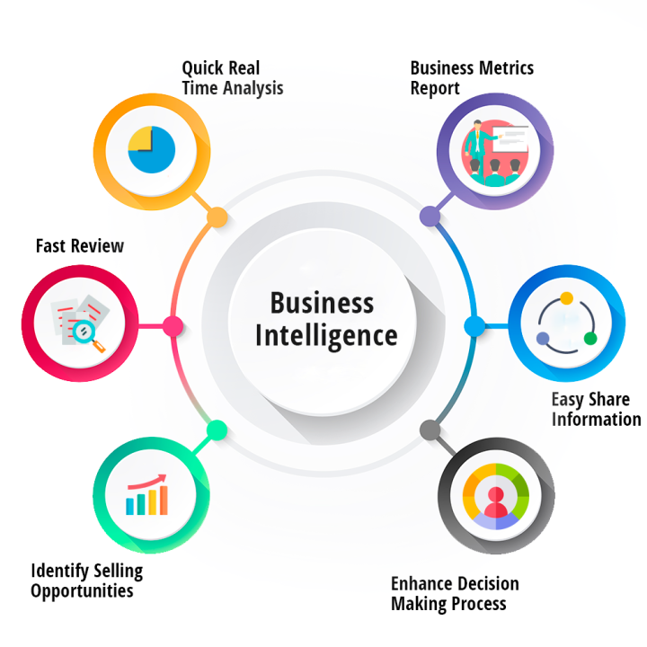
Business Intelligence
Business Intelligence (BI) refers to technologies, processes, and strategies used to analyze business data and support decision-making.
Reporting & Decision Support Systems – Helps executives make data-driven decisions.
Business Analytics – Uses historical data to identify trends and make predictions.
Customer Analytics – Analyzes customer behavior, preferences, and segmentation.
Operational Analytics – Improves business processes by optimizing efficiency and productivity.
🔹 Softwares Mostly Used?
Power BI, Tableau – For interactive reporting and dashboards.
SQL, Snowflake, Google BigQuery – For data storage and querying.
Python (Pandas, NumPy), R – For advanced analytics.
Excel, Google Data Studio – For traditional reporting and analysis.

Slide 11
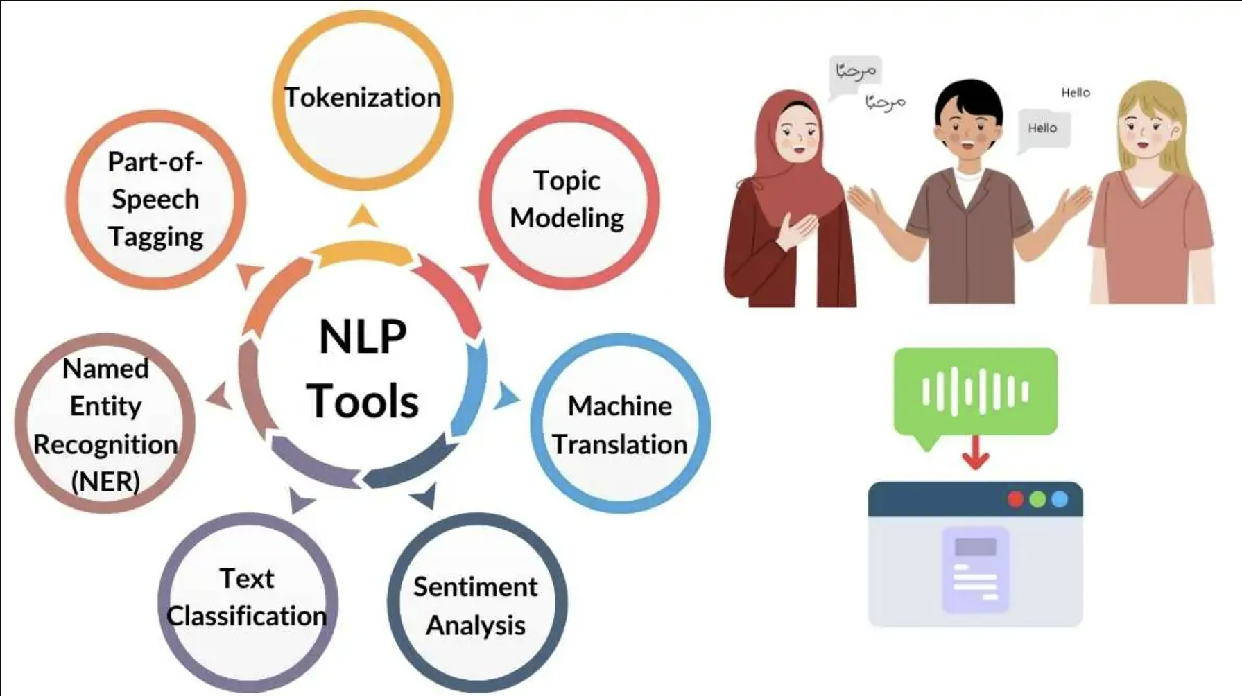
Natural Language Processing (NLP)
Natural Language Processing (NLP) is a branch of artificial intelligence that enables computers to understand, interpret, and generate human language.
Sentiment Analysis – Determines whether text expresses a positive, negative, or neutral sentiment.
Text Mining – Extracts valuable insights and patterns from large volumes of textual data.
Text Classification – Categorizes text into predefined groups, such as spam detection or document classification.
Topic Modeling – Identifies hidden topics within a collection of text documents.
🔹 Softwares Mostly Used?
NLP Libraries: NLTK, spaCy, Transformers (Hugging Face).
Machine Learning: TensorFlow, PyTorch, Scikit-learn.
Data Processing: Pandas, OpenAI GPT, IBM Watson NLP.
Cloud NLP Services: Google Cloud Natural Language API, AWS Comprehend.
🔹 Application?
Social Media Monitoring: Brand sentiment analysis.
Chatbots & Virtual Assistants: Automated customer support.
Healthcare: Medical text analysis and diagnosis recommendations.
Finance: Analyzing financial reports and news.
Search Engines: Enhancing search results and relevance.
Notes:
Topic Modeling is an unsupervised machine learning technique used to identify hidden themes or topics within a large collection of text documents.

Slide 12
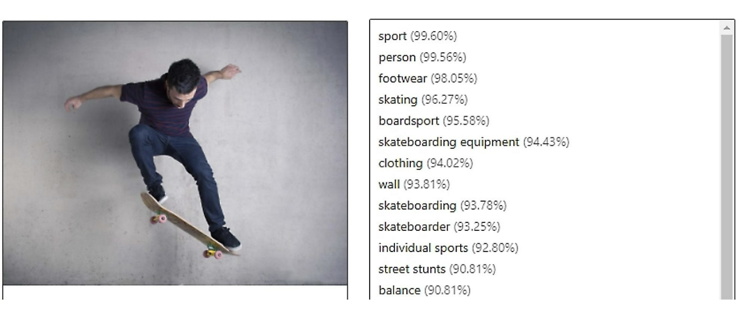
Computer Vision
Computer Vision is a field of artificial intelligence that enables machines to interpret and understand visual data from the real world.
Object Recognition – Detects and classifies objects within an image or video.
Image Processing – Enhances and manipulates images for better analysis.
Deep Learning in Vision – Uses CNNs (Convolutional Neural Networks) for advanced pattern recognition.
GANs (Generative Adversarial Networks) – Generates new, realistic images and enhances synthetic data creation.
🔹 Softwares Mostly Used?
OpenCV – Open-source image processing library.
TensorFlow & PyTorch – Deep learning frameworks for vision tasks.
YOLO (You Only Look Once) – Real-time object detection.
FastAI – High-level deep learning library for vision tasks.
Google Cloud Vision, AWS Rekognition – Cloud-based image analysis.
🔹 Application?
Healthcare: Medical imaging analysis (MRI, X-ray, CT scans).
Autonomous Vehicles: Object detection and path recognition.
Retail & Security: Facial recognition and surveillance.
Manufacturing: Quality control and defect detection.
Augmented Reality (AR) & Virtual Reality (VR): Real-world interaction with virtual objects.

Slide 13
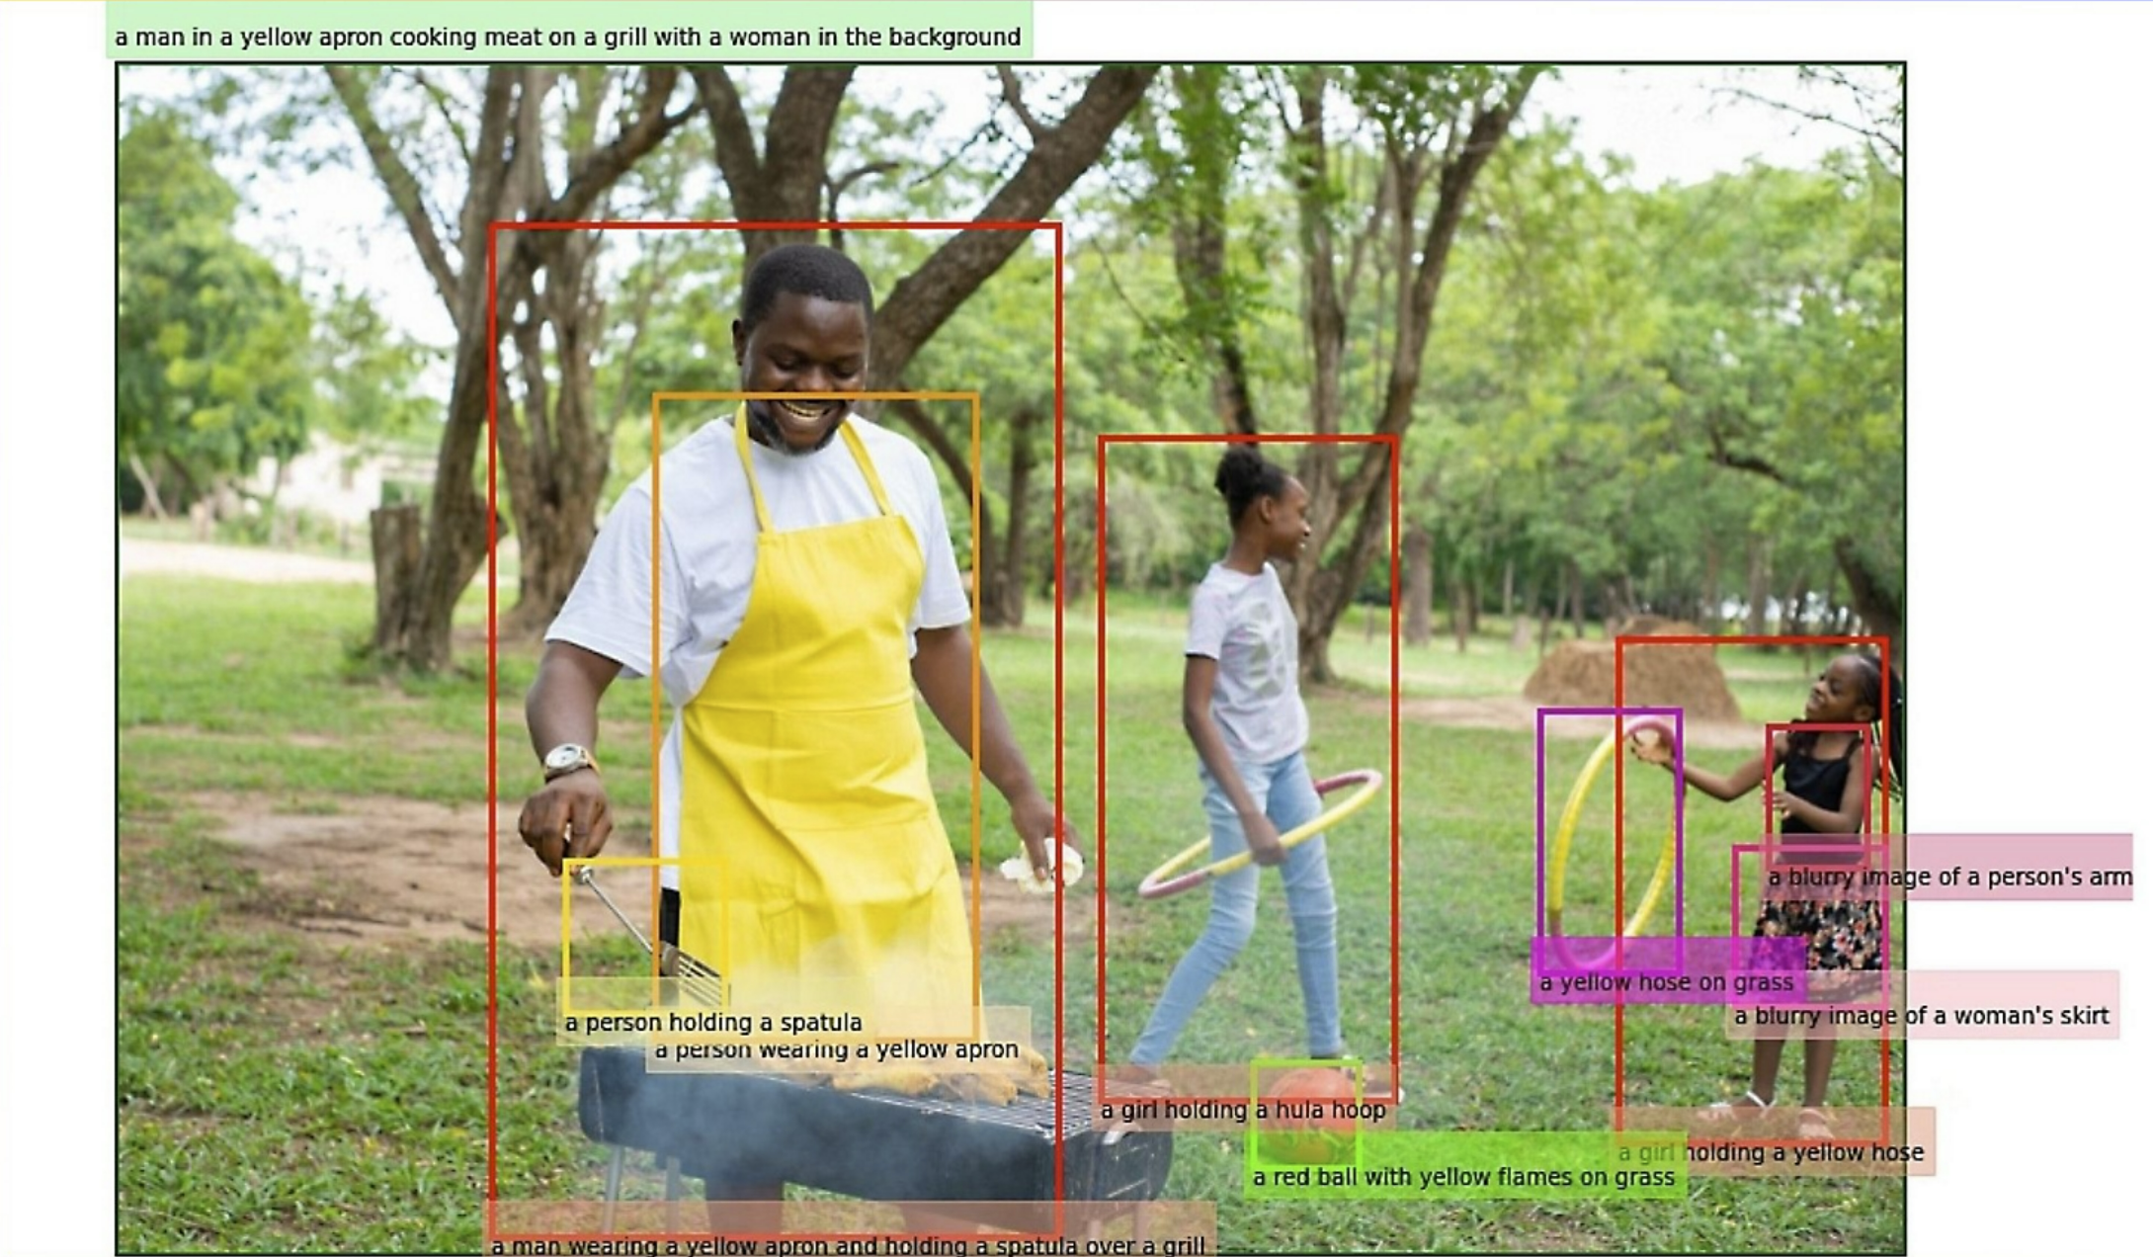
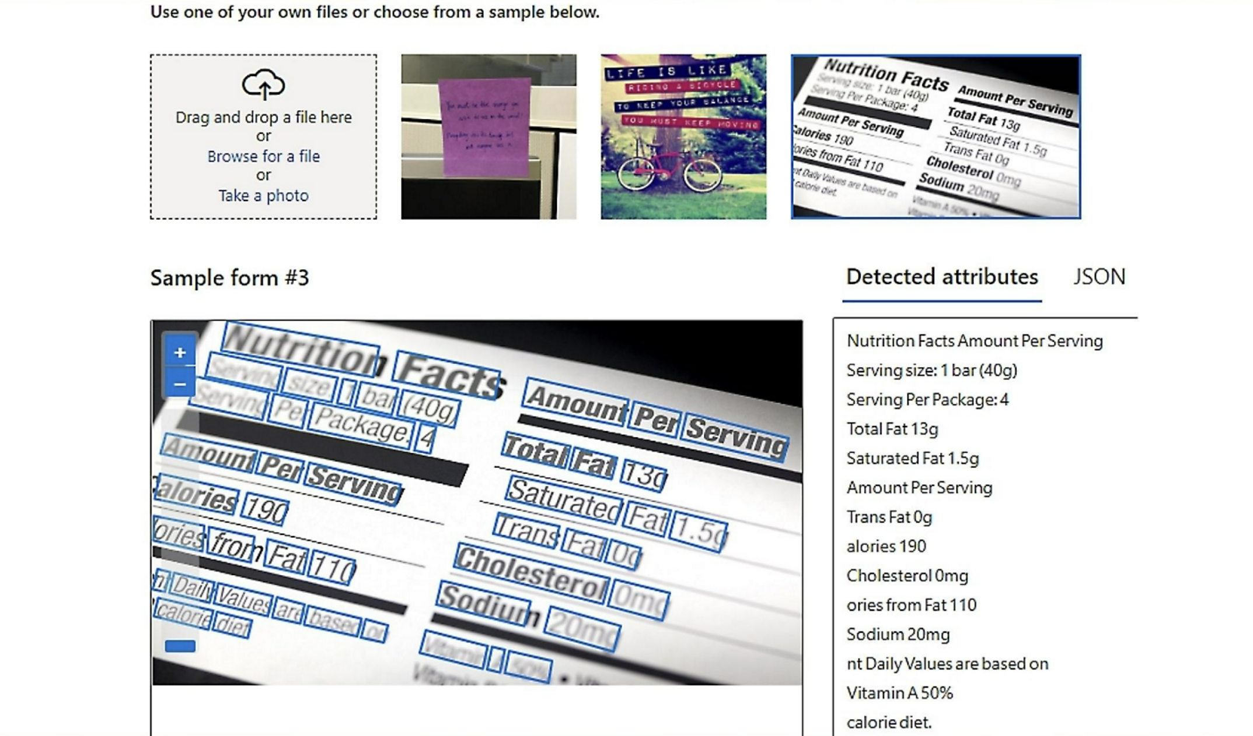
Computer Vision Application

Slide 14
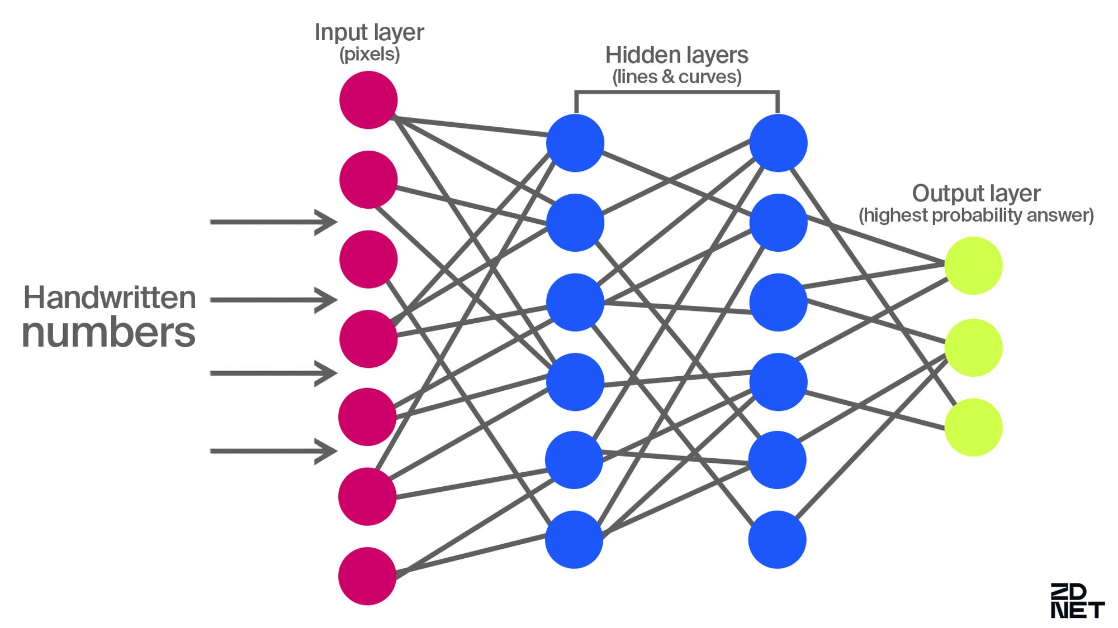



Deep Learning
Deep Learning is a subset of machine learning that uses neural networks with multiple layers to process and learn from vast amounts of data.
Artificial Neural Networks (ANNs) – Simulate human brain neurons for decision-making and classification tasks.
Convolutional Neural Networks (CNNs) – Used for image processing, facial recognition, and object detection.
Recurrent Neural Networks (RNNs) – Handle sequential data like speech recognition and language modeling.
Generative Adversarial Networks (GANs) – Generate new data, images, and deepfake technology.
Transformers – Power NLP applications like ChatGPT and BERT for text generation and understanding.
🔹 Softwares & Tools Used?
TensorFlow – Open-source deep learning framework by Google.
PyTorch – Popular deep learning library developed by Facebook AI.
Keras – High-level API for building deep learning models.
OpenCV – Image and video processing for computer vision applications.
NVIDIA CUDA – GPU acceleration for training deep learning models.
🔹 Application?
Computer Vision: Image recognition, autonomous vehicles, medical imaging.
Natural Language Processing (NLP): Chatbots, translation, text generation.
Healthcare: Disease diagnosis, drug discovery, genomics.
Finance: Algorithmic trading, fraud detection, risk assessment.
Robotics: AI-powered automation and human-like interaction.
Notes:
. Definition
ML: A broader field of AI where algorithms learn from data to make predictions or decisions.
DL: A subset of ML that uses neural networks with multiple layers (deep neural networks) to learn complex patterns.
2. Data Dependency
ML: Performs well on structured and smaller datasets.
DL: Requires large amounts of data for effective training.
3. Feature Engineering
ML: Requires manual feature selection and engineering by domain experts.
DL: Automatically extracts features through layers of neural networks.
4. Model Complexity
ML: Uses algorithms like decision trees, SVMs, random forests, and gradient boosting.
DL: Uses deep neural networks (CNNs, RNNs, Transformers) with millions of parameters.
5. Training Time & Resources
ML: Faster training, can run on standard CPUs.
DL: Requires extensive computation (often GPUs/TPUs), longer training times.
6. Interpretability
ML: Models like decision trees and linear regression are more interpretable.
DL: Often considered a "black box" due to complex weight interactions.
7. Applications
ML: Used in fraud detection, recommendation systems, predictive analytics, and traditional AI tasks.
DL: Used in image recognition, NLP (chatbots, transformers), speech recognition, and self-driving cars.
8. Performance Scaling
ML: Performance plateaus as data size increases.
DL: Performance improves significantly with more data and compute power.
9. Dependency on Domain Knowledge
ML: Requires domain expertise to engineer meaningful features.
DL: Can automatically learn relevant features, reducing reliance on domain expertise.
10. When to Use What?
Use ML: When you have limited data, need explainability, and want faster training.
Use DL: When working with large datasets, complex patterns (e.g., images, audio, NLP), and have the necessary computing power.
Sora (OpenAI)
GPT (Generative Pre-trained Transformer)
Purpose: A natural language processing model that generates human-like text. Used for chatbots, content creation, summarization, and text-based AI applications.
Bloom
Purpose: A large open-source multilingual AI model similar to GPT. It is designed for text generation, translation, and various NLP tasks.
DeepDream
Purpose: A deep learning model by Google that enhances and modifies images to create dream-like, psychedelic visual effects. Used in artistic image generation.
DALL·E
Purpose: An AI model that generates images from textual descriptions. It is used in creative design, digital art, and visualization.
Stable Diffusion
Purpose: A deep learning model used for text-to-image generation. It allows for creating high-quality images based on user prompts.
Whisper
Purpose: An automatic speech recognition (ASR) model developed by OpenAI. It is used for transcribing spoken language into text.
Wavenet
Purpose: A deep generative model for creating human-like speech synthesis. Used in text-to-speech (TTS) applications.
Codex
Purpose: A code-generation AI model that helps programmers by generating code snippets from natural language prompts. It powers tools like GitHub Copilot.
MidJourney
Purpose: An AI-powered image-generation tool that specializes in creating artistic and detailed digital artworks from text descriptions.
Wavenet: What It Can Do
Wavenet is a deep generative model developed by DeepMind (Google) for generating high-quality, natural-sounding speech. It is a text-to-speech (TTS) synthesis model that significantly improves over traditional speech synthesis systems.
Key Capabilities of Wavenet:
Natural-Sounding Speech Generation
Wavenet generates realistic human-like speech with natural intonation and smooth transitions between words.
It captures the nuances of human speech better than traditional concatenative or parametric synthesis models.
Multi-Language & Multi-Speaker Support
It can generate speech in multiple languages and different voices with high clarity.
Can be trained on different speakers to mimic their voice styles.
Expressive Speech & Emotional Tone
Unlike traditional text-to-speech systems, Wavenet can inject emotions, pitch variations, and natural pauses, making the speech more engaging and lifelike.
Voice Cloning & Personalization
Wavenet can be used to clone and generate synthetic voices that sound almost identical to real human voices.
Used in applications like AI assistants, audiobooks, and automated call centers.
Text-to-Speech (TTS) Applications
Powers Google Assistant, Google Translate, and Google’s TTS API.
Used in voice assistants, customer service chatbots, and accessibility tools for visually impaired users.
Music & Sound Synthesis
Wavenet can generate raw audio waveforms beyond speech, making it useful for music and sound design applications.
Where is Wavenet Used?
Google Assistant & Voice AI → Improves digital assistant voices.
Google Translate → Provides natural-sounding translations in multiple languages.
Audiobooks & Podcasts → Converts text into high-quality spoken narration.
Customer Service Automation → Used in chatbots and IVR (Interactive Voice Response) systems.
Accessibility Tools → Helps visually impaired users by converting text into spoken words.
Why is Wavenet Better than Traditional TTS?
Unlike concatenative speech synthesis, which stitches together pre-recorded sound clips, Wavenet generates speech from scratch, making it more fluid and natural.
It models raw audio waveforms rather than relying on phonemes, making its speech more realistic.
Reduces robotic, unnatural sounds common in older TTS systems.
Applications in Healthcare:
These AI models contribute to various aspects of healthcare:
Medical Imaging
AI models assist in analyzing medical images like MRIs, X-rays, and CT scans, helping detect diseases early.
Drug Discovery
AI accelerates drug development by predicting molecular interactions, optimizing chemical structures, and reducing research time.
Personalized Medicine
AI tailors treatment plans based on a patient’s genetic profile and medical history for improved healthcare outcomes.
Population Health Management
AI analyzes health data from large populations to identify trends, predict disease outbreaks, and enhance healthcare planning.

Slide 15
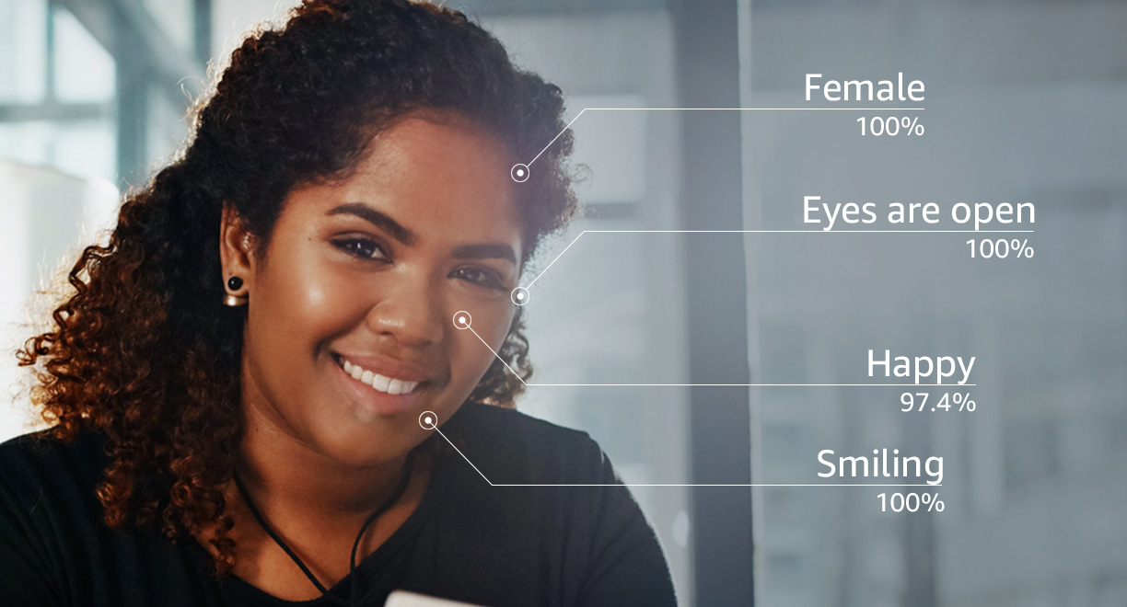
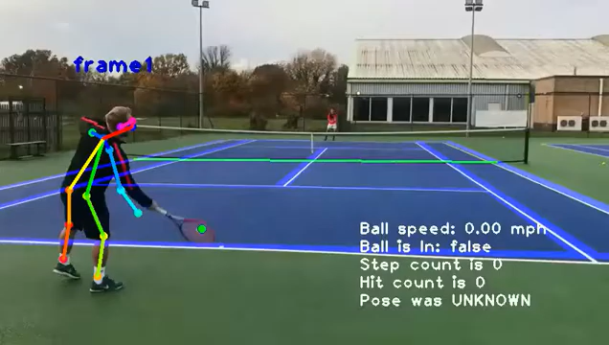
Computer Vision Application

Slide 16

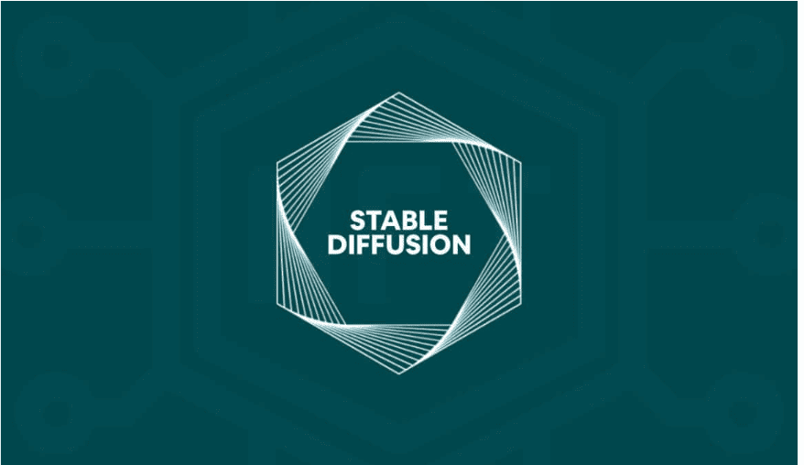


Generative AI
Generative AI refers to machines that can perform any intellectual task a human can, with reasoning, learning, and adaptability.
AI Ethics – Ensuring AI systems align with human values and fairness.
AI Governance – Regulations and policies for AI deployment.
AI Safety – Preventing unintended consequences of AI actions.
AI in Society – The impact of AI on jobs, culture, and human interactions.
🔹 Softwares & Platforms Used?
OpenAI (GPT-based models, DALL·E) – AI language and vision applications.
Google DeepMind (AlphaFold, AlphaGo) – Advanced AI research.
IBM Watson – AI for business and healthcare.
Ethical AI Toolkits (Fairness Indicators, AI Explainability 360) – Ensuring responsible AI.
🔹 Application?
Autonomous Robotics: AI-driven robots in industries.
Healthcare: AI-assisted medical diagnosis and research.
Education: AI-driven learning systems and tutoring.
Smart Assistants: AI for seamless human-computer interactions.
Policy & Regulation: Frameworks for safe AI development.
Notes:
Sora (OpenAI)
GPT (Generative Pre-trained Transformer)
Purpose: A natural language processing model that generates human-like text. Used for chatbots, content creation, summarization, and text-based AI applications.
Bloom
Purpose: A large open-source multilingual AI model similar to GPT. It is designed for text generation, translation, and various NLP tasks.
DeepDream
Purpose: A deep learning model by Google that enhances and modifies images to create dream-like, psychedelic visual effects. Used in artistic image generation.
DALL·E
Purpose: An AI model that generates images from textual descriptions. It is used in creative design, digital art, and visualization.
Stable Diffusion
Purpose: A deep learning model used for text-to-image generation. It allows for creating high-quality images based on user prompts.
Whisper
Purpose: An automatic speech recognition (ASR) model developed by OpenAI. It is used for transcribing spoken language into text.
Wavenet
Purpose: A deep generative model for creating human-like speech synthesis. Used in text-to-speech (TTS) applications.
Codex
Purpose: A code-generation AI model that helps programmers by generating code snippets from natural language prompts. It powers tools like GitHub Copilot.
MidJourney
Purpose: An AI-powered image-generation tool that specializes in creating artistic and detailed digital artworks from text descriptions.
Wavenet: What It Can Do
Wavenet is a deep generative model developed by DeepMind (Google) for generating high-quality, natural-sounding speech. It is a text-to-speech (TTS) synthesis model that significantly improves over traditional speech synthesis systems.
Key Capabilities of Wavenet:
Natural-Sounding Speech Generation
Wavenet generates realistic human-like speech with natural intonation and smooth transitions between words.
It captures the nuances of human speech better than traditional concatenative or parametric synthesis models.
Multi-Language & Multi-Speaker Support
It can generate speech in multiple languages and different voices with high clarity.
Can be trained on different speakers to mimic their voice styles.
Expressive Speech & Emotional Tone
Unlike traditional text-to-speech systems, Wavenet can inject emotions, pitch variations, and natural pauses, making the speech more engaging and lifelike.
Voice Cloning & Personalization
Wavenet can be used to clone and generate synthetic voices that sound almost identical to real human voices.
Used in applications like AI assistants, audiobooks, and automated call centers.
Text-to-Speech (TTS) Applications
Powers Google Assistant, Google Translate, and Google’s TTS API.
Used in voice assistants, customer service chatbots, and accessibility tools for visually impaired users.
Music & Sound Synthesis
Wavenet can generate raw audio waveforms beyond speech, making it useful for music and sound design applications.
Where is Wavenet Used?
Google Assistant & Voice AI → Improves digital assistant voices.
Google Translate → Provides natural-sounding translations in multiple languages.
Audiobooks & Podcasts → Converts text into high-quality spoken narration.
Customer Service Automation → Used in chatbots and IVR (Interactive Voice Response) systems.
Accessibility Tools → Helps visually impaired users by converting text into spoken words.
Why is Wavenet Better than Traditional TTS?
Unlike concatenative speech synthesis, which stitches together pre-recorded sound clips, Wavenet generates speech from scratch, making it more fluid and natural.
It models raw audio waveforms rather than relying on phonemes, making its speech more realistic.
Reduces robotic, unnatural sounds common in older TTS systems.
Applications in Healthcare:
These AI models contribute to various aspects of healthcare:
Medical Imaging
AI models assist in analyzing medical images like MRIs, X-rays, and CT scans, helping detect diseases early.
Drug Discovery
AI accelerates drug development by predicting molecular interactions, optimizing chemical structures, and reducing research time.
Personalized Medicine
AI tailors treatment plans based on a patient’s genetic profile and medical history for improved healthcare outcomes.
Population Health Management
AI analyzes health data from large populations to identify trends, predict disease outbreaks, and enhance healthcare planning.

Slide 17
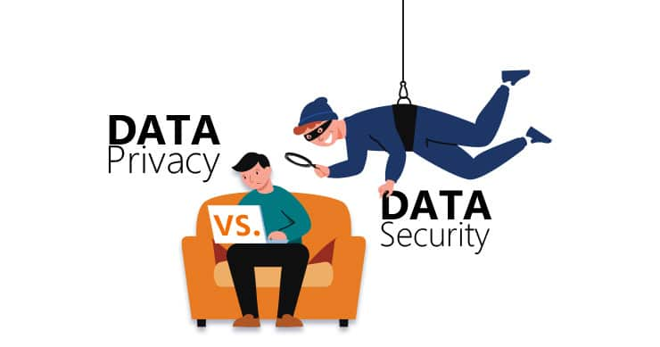
Data Security and Privacy
Data Security and Privacy involve protecting sensitive information from unauthorized access, breaches, and misuse.
Data Anonymization – Removing personally identifiable information (PII) to protect user privacy.
Secure Data Practices – Implementing encryption, authentication, and access controls to safeguard data.
Compliance (GDPR, HIPAA) – Adhering to legal regulations to ensure responsible data handling.
🔹 Softwares & Tools Used?
Encryption: AES, RSA, SSL/TLS protocols.
Data Masking & Anonymization: Aircloak, ARX, IBM Guardium.
Compliance Management: OneTrust, TrustArc, Varonis.
Secure Data Storage: AWS KMS, Google Cloud Security, Azure Confidential Computing.

Slide 18
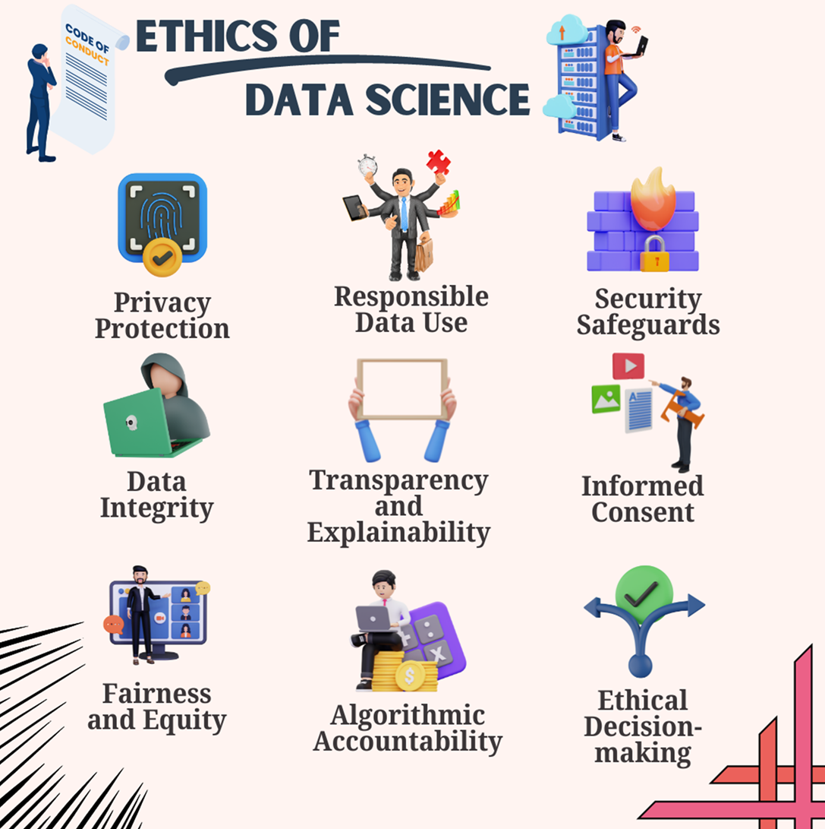
Ethical AI and Responsible Data Science
Ethical AI and Responsible Data Science ensure AI models and data-driven decisions are fair, unbiased, transparent, and respectful of privacy.
Bias Detection – Identifying and mitigating biases in AI models to ensure fairness.
Ethical Use of Data – Ensuring data is collected and used responsibly without violating privacy.
Transparency and Explainability – Making AI models interpretable so users can understand how decisions are made.
🔹 Softwares & Tools Used?
AI Fairness & Bias Detection: IBM AI Fairness 360, Fairlearn, SHAP (Shapley Additive Explanations).
Explainable AI: Google’s What-If Tool, LIME (Local Interpretable Model-Agnostic Explanations).
Data Ethics Compliance: OneTrust, TrustArc for data privacy governance.
AI Model Governance: TensorFlow Model Card Toolkit, Microsoft Responsible AI.

Slide 19
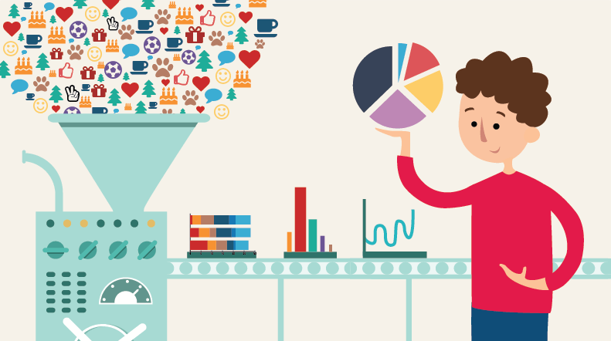
Data Cleaning and Preprocessing
Data Cleaning and Preprocessing involve preparing raw data for analysis and modeling by handling inconsistencies, missing values, and redundant information.
Handling Missing Values – Filling or removing missing data to improve model accuracy.
Encoding Categorical Data – Converting categorical variables into numerical formats for machine learning models.
Feature Engineering – Creating new meaningful features from raw data.
Outlier Detection – Identifying and managing anomalies that could skew analysis.
Data Reduction – Reducing dataset dimensions for efficiency.
Data Transformation – Scaling and normalizing data for better consistency.
🔹 Softwares & Tools Used?
Python Libraries: Pandas, NumPy, Scikit-learn.
Data Imputation: KNN Imputer, SimpleImputer (Scikit-learn).
Feature Engineering: FeatureTools, SciPy, OpenAI Codex.
Outlier Detection: Isolation Forest, Z-score, DBSCAN.
Data Transformation: MinMaxScaler, StandardScaler, PCA (Principal Component Analysis).

Slide 20
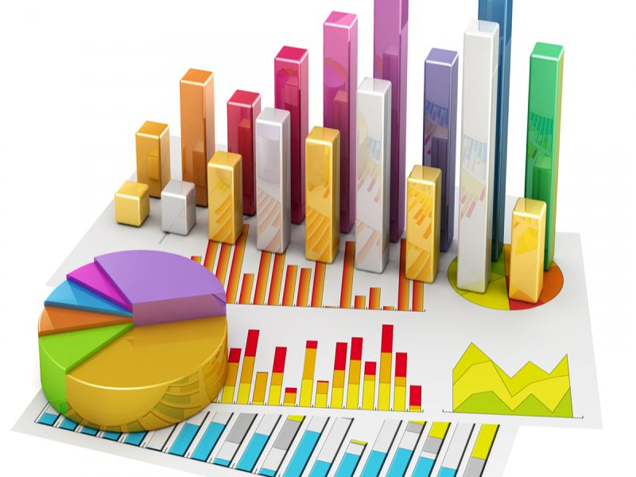
Statistical Analysis
Statistical Analysis is the process of collecting, organizing, and interpreting numerical data to uncover patterns and insights.
Hypothesis Testing – Validating assumptions about data using statistical tests.
Inferential Statistics – Drawing conclusions from sample data to apply to larger populations.
Bayesian Statistics – Applying probability to update predictions based on new data.
Survival Analysis – Examining time-to-event data (e.g., predicting patient survival rates).
Time Series Analysis – Analyzing trends and forecasting future values (e.g., stock prices).
Regression Analysis – Identifying relationships between variables and making predictions.
🔹 Softwares & Tools Used?
R (ggplot2, dplyr, caret) – Statistical computing and visualization.
Python (SciPy, Statsmodels, NumPy, Pandas) – Data analysis and hypothesis testing.
SPSS, SAS – Advanced statistical modeling for research and business.
Excel – Basic statistical functions and regression analysis.
🔹 Application?
Finance: Risk modeling, market trend analysis.
Healthcare: Disease prediction, survival rate estimation.
Marketing: Customer behavior analysis, A/B testing.
Engineering: Quality control and reliability testing.
Social Sciences: Survey analysis and policy research.

Slide 21
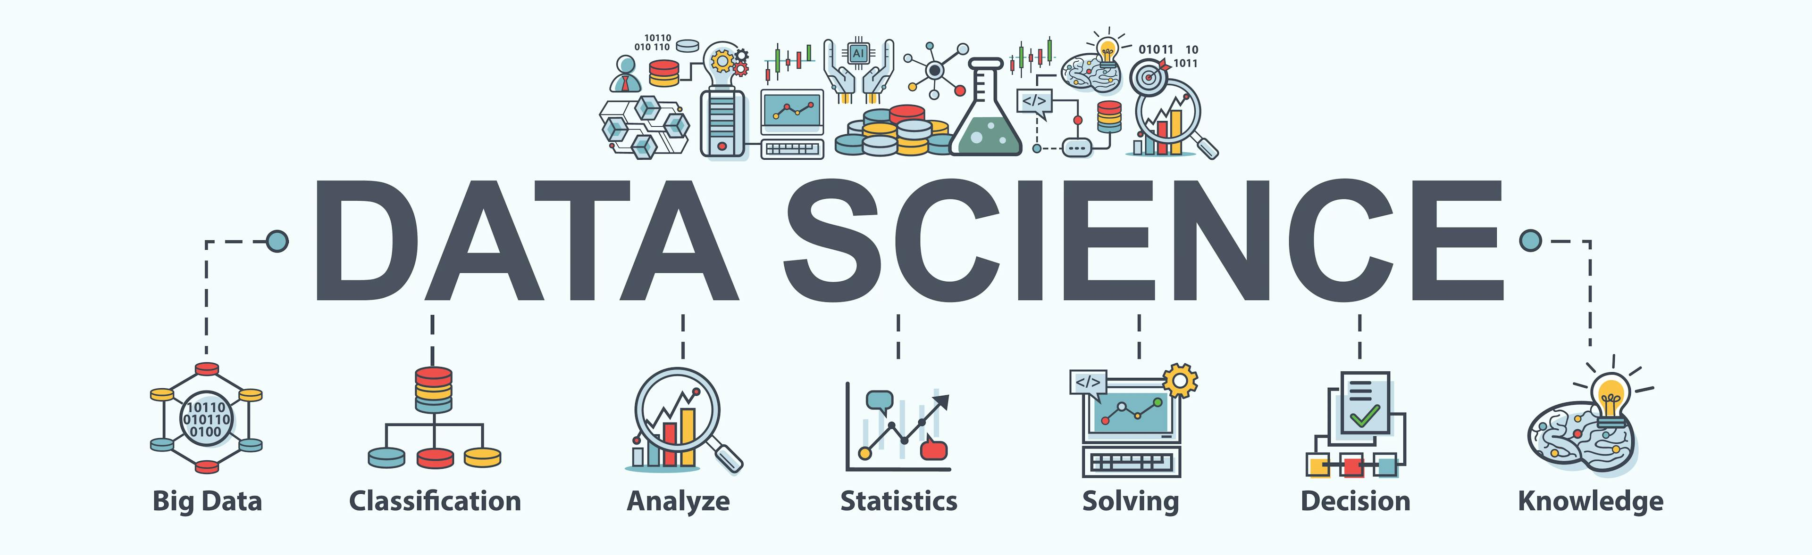
Data Science in Various Domains
Data Science applies statistical, machine learning, and AI techniques to extract insights and make data-driven decisions across industries.
Financial Analytics – Predicting stock prices, fraud detection, risk assessment.
Healthcare Analytics – Patient diagnosis, predictive modeling, medical imaging analysis.
Geospatial Analytics – Mapping trends, location-based insights, urban planning.
Sports Analytics – Performance tracking, injury prevention, game strategy optimization.
Marketing & Retail Analytics – Customer segmentation, demand forecasting, personalized recommendations.
🔹 Softwares & Tools Used?
Python (Pandas, Scikit-learn, TensorFlow) – Data processing & machine learning.
R (ggplot2, tidymodels) – Statistical computing & data visualization.
SQL, Apache Spark – Big data management & querying.
Tableau, Power BI – Interactive visual analytics.
GIS Tools (ArcGIS, QGIS) – Geospatial data processing.

